Slide 1


Representational Form of Perceptual Average
MyoungAh Kim
Graduate Program in Cognitive Science

Slide 2



Slide 3
Is mean represented as a single size?

Slide 4
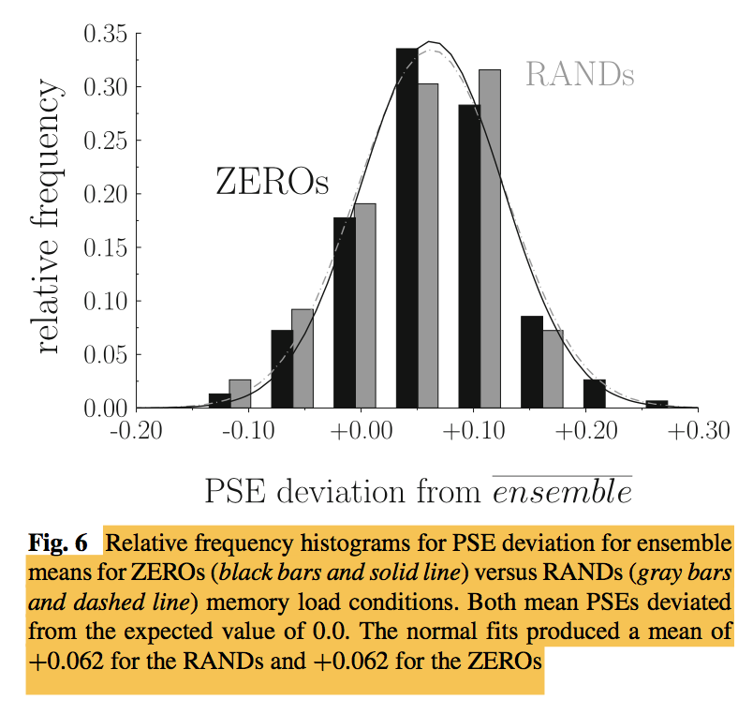
Is mean represented as a single size?
PROBLEM 1. Overestimation of the mean
Overestimation
3% ~ 40% (avg 6.2%)bias
Bauer (2017)

Slide 5
Is mean represented as a single size?
PROBLEM 2. Interrelationship between different properties
Mean
Variance
Numerosity
3
8
2
5
7
4
9
1
6
Lee, Baek, & Chong (2016)
Hurewitz, Gelman, & Schnitzer (2006)
Chong & Treisman (2005)
Corbett et al. (2012)
Tong et al. (2015)
Summed area

Slide 6

Disparity between two ensembles → Mean estimation?
Set Size
Variance
Exp 1 & 2
Exp 3
Exp 4
Notes:
checked the difference in the mean size estimation error between single probe tasks versus set probe tasks across different studies is an actual robust perceptual phenomenon that appears within participant

Slide 7
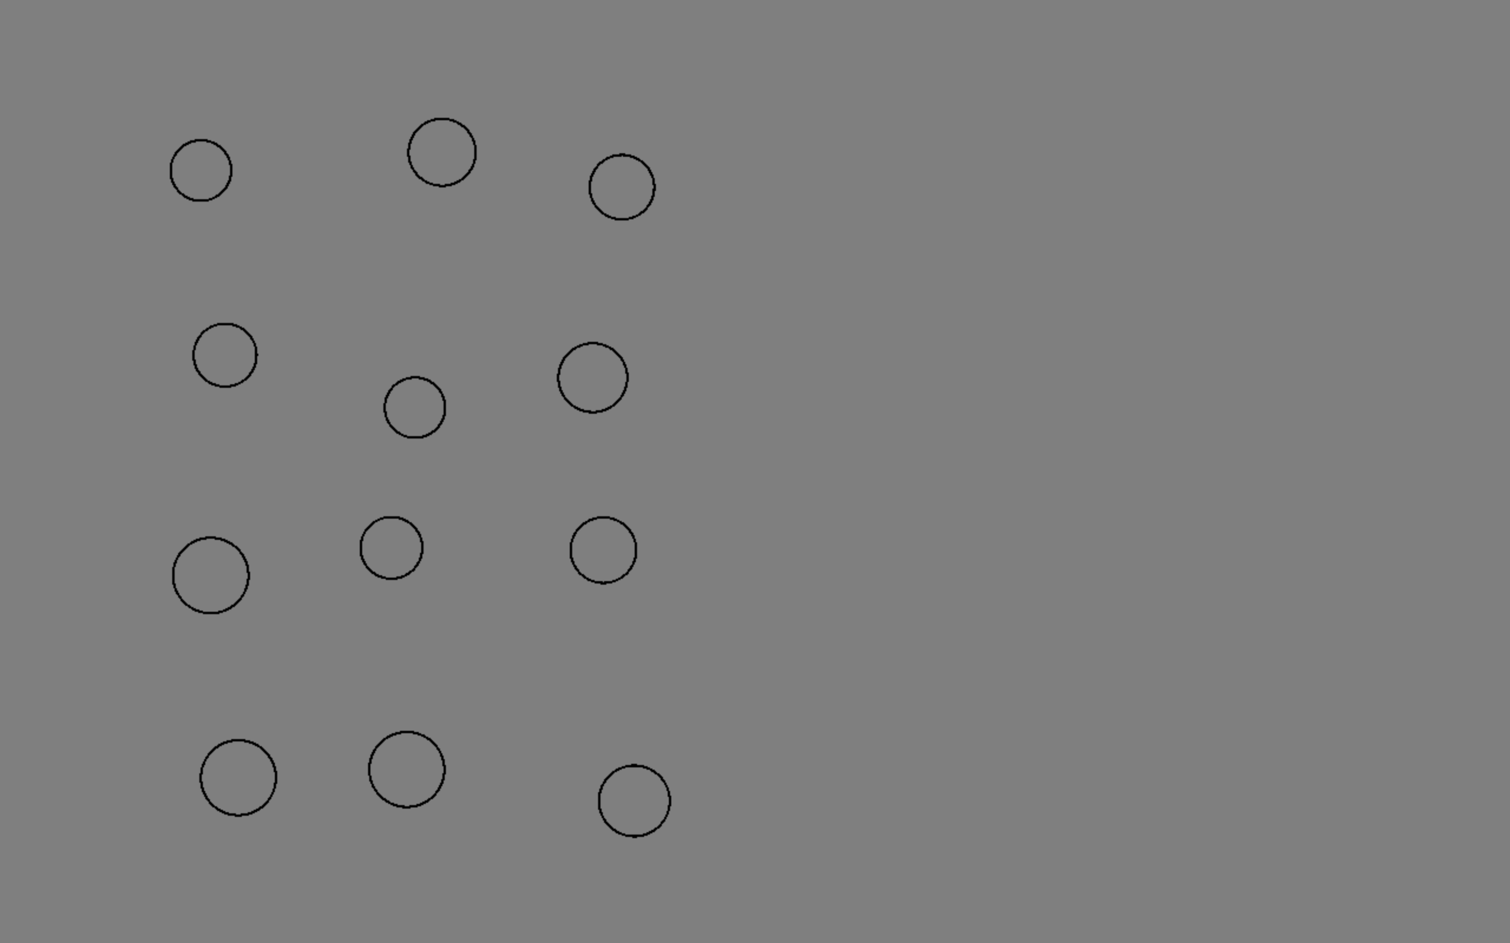

Slide 8


Slide 9
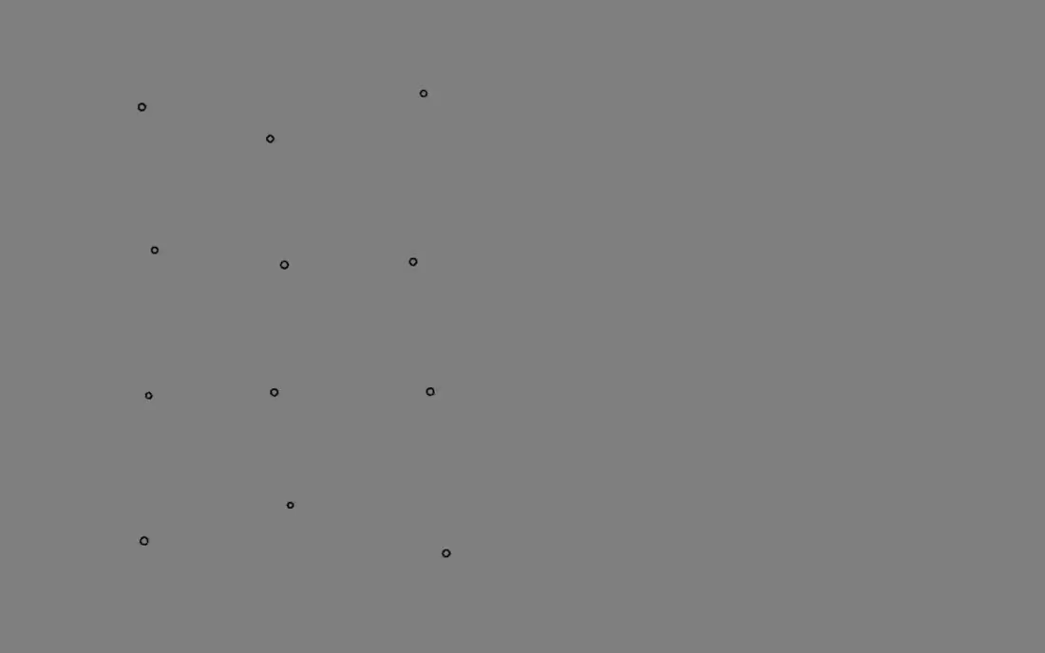

Slide 10
Actual Mean Size
- Final Probe Size
Relative Mean Size Difference =
Actual Mean Size

Slide 11
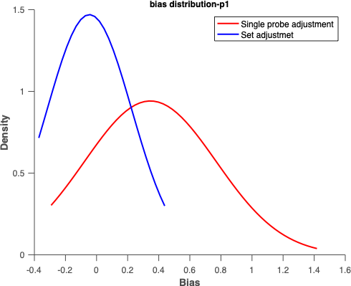
Actual Mean Size
- Final Probe Size
Relative Mean Size Difference =
Actual Mean Size
Error Distribution of Participant 1
M
Single Probe
Set Probe
Single Probe
Set Probe
sd
M
Response Variance
Density
Density
sd
Response Variance
BIAS
BIAS
Relative Mean Size Difference
Relative Mean Size Difference
Relative Mean Size Difference
Relative Mean Size Difference

Slide 12
EXPERIMENT 2
Set Size Disparity (16:1, 16:4, 16:9, 16:16)
Fixation
(500-1000 ms)
Standard Display
(100 ms)
Blank
(500 ms)
Probe Display
(Until response)
+
16 : 1
16 : 4
16 : 9
16 : 16

Slide 13
Bias reduces with set size. Response variance is smaller for set probes.
EXPERIMENT 2
( n = 8 )
( n = 8 )
***
**

Slide 14
EXPERIMENT 2
Fixation
(500-1000 ms)
Standard Display
(100 ms)
Blank
(500 ms)
Probe Display
(Until response)
+
16 : 1
16 : 4
16 : 9
16 : 16

Slide 15
EXPERIMENT 3
Side Congruency (Same Side, Different Side) x Set Size Disparity (9:4, 9:9, 9:16)
standard Display
probe Display
Same Side
+
+
Different Side
+
+

Slide 16
EXPERIMENT 3
Set size effect is more evident in different side.
9:4
9:9
9:16
( n = 8 )
( n = 8 )
n.s.
**
n.s.

Slide 17
EXPERIMENT 4
Variability Disparity (Congruent Variance, Incongruent Variance)
Congruent Variance
Incongruent Variance
Standard Display
probe Display
standard Display
probe Display
Low Variance
Standard Display
standard Display
probe Display
standard Display
probe Display
High Variance
Standard Display
sd = mean/3
sd = mean/8

Slide 18
EXPERIMENT 4
No bias when variance is congruent.
High Variance
Standard Display
Low Variance
Standard Display
( n = 6 )
( n = 6 )
***

Slide 19
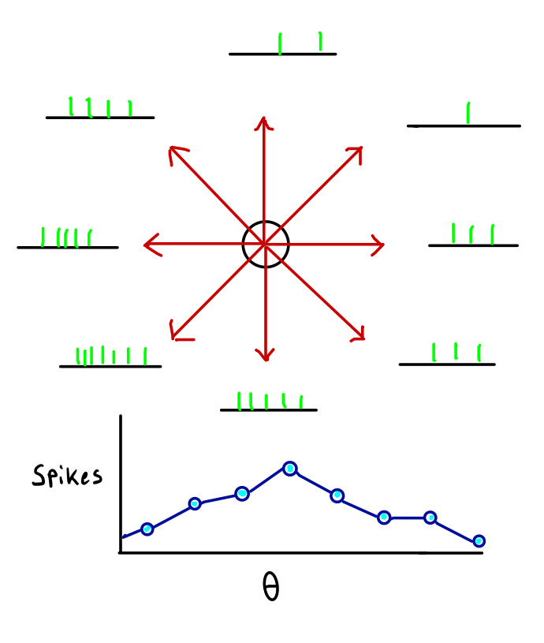
Summary
Population Coding
Accurate comparison of mean size was contingent on the disparity between the standard display & probe display.
Estimation bias & response variance increased when set size/variance was different.
This provides strong evidence that mean representation is not as a single unit, but includes ensembles of statistical properties, such as numerosity and variance.
Georgopoulos, Schwartz, & Kettner (1986)

Slide 20
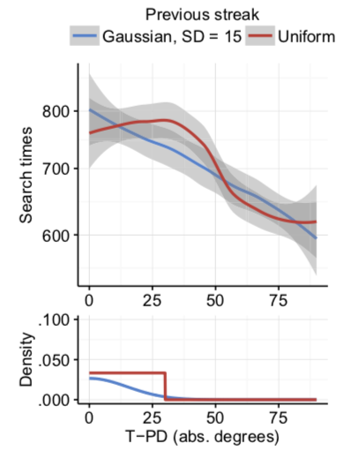
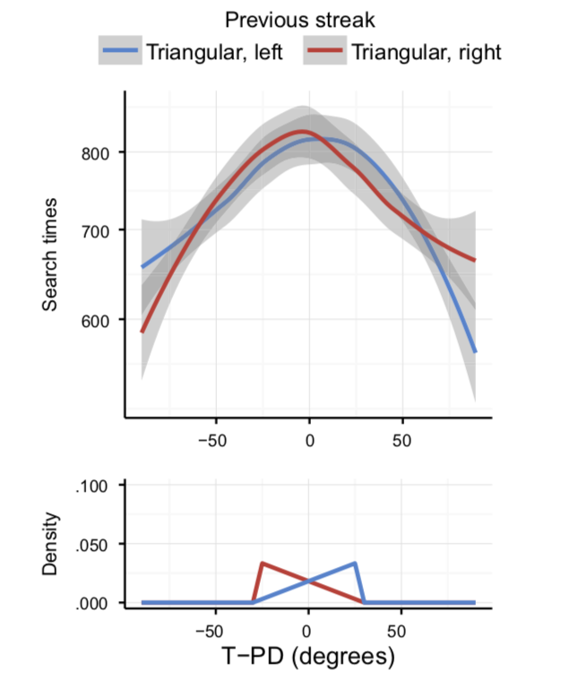
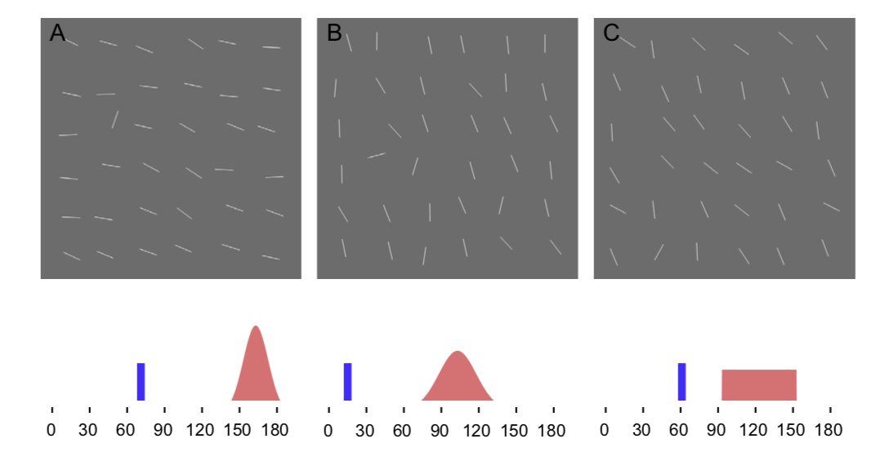

Chetverikov, Campana, & Kristjansson (2016)

Slide 21
Averaging
Population summary
Individual
representation
Ensemble
representation

Slide 22
Perceptual averaging: not one mean but population summary.
VS
??
To compare with different numerosity / variance incurs
CONVERSION COST (estimation error, loss of precision)

Slide 23
Perceptual averaging: not one mean but population summary.
VS
Overestimation
To compare with different numerosity / variance incurs
CONVERSION COST (estimation error, loss of precision)

Slide 24


Slide 25





Slide 26
Conclusions
Perceptual averaging does not reduce the ensemble in a form of a single mean.
Mean representation is more like a population summary which includes an ensemble of statistical properties, such as numerosity and variance.
Population summary can avoid confusion in the natural world, distinguishing between things that have similar average but only marked by subtle differences.

Slide 27

Thank you

Slide 28
Appendix

Slide 29
Most seems to assume that the mean is represented somewhat like a exemplar value, like single size.
Display
Response
Response
Is the test circle
larger or smaller than the average size of display?
Use mouse to adjust test circle to average circle size of display

Slide 30
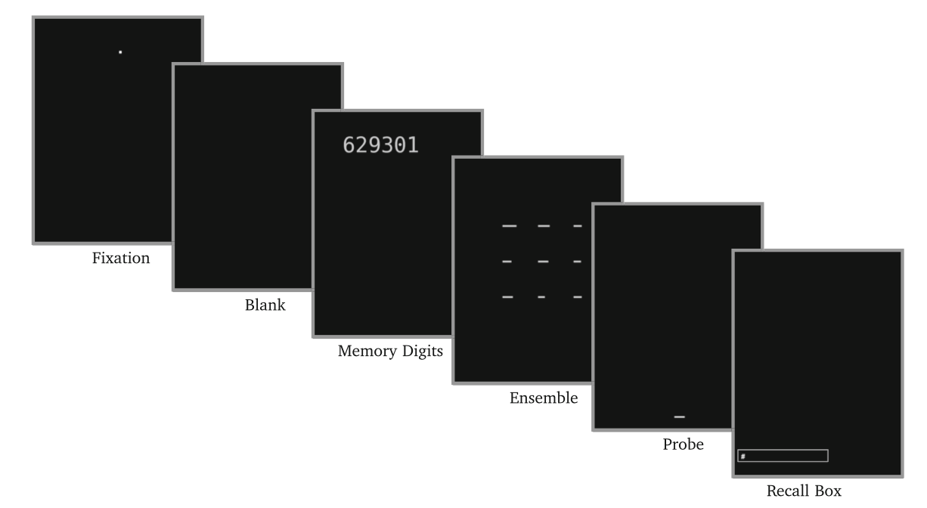
Single probe studies consistently report
positive bias (overestimation of the mean).
3% ~ 40% (avg 6.2%)bias
Ensemble
Probe
Probe greater than the mean?
Bauer (2017)

Slide 31
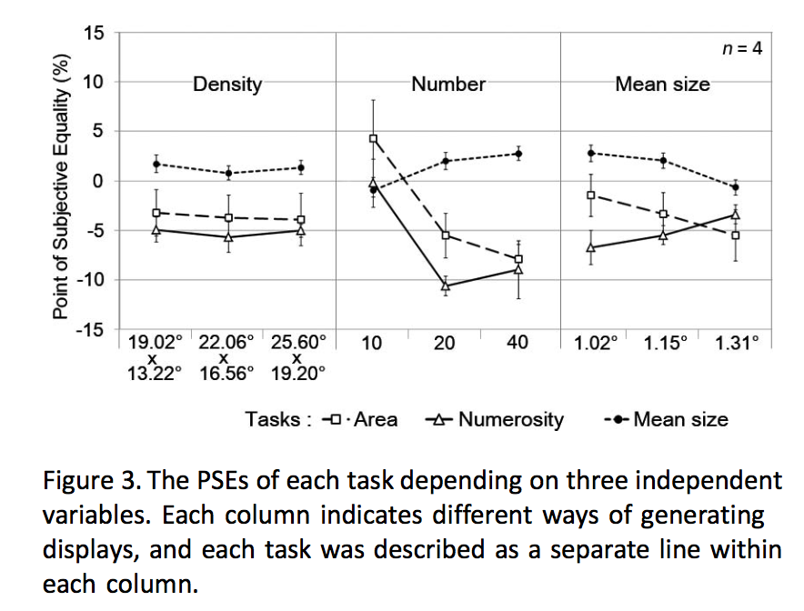
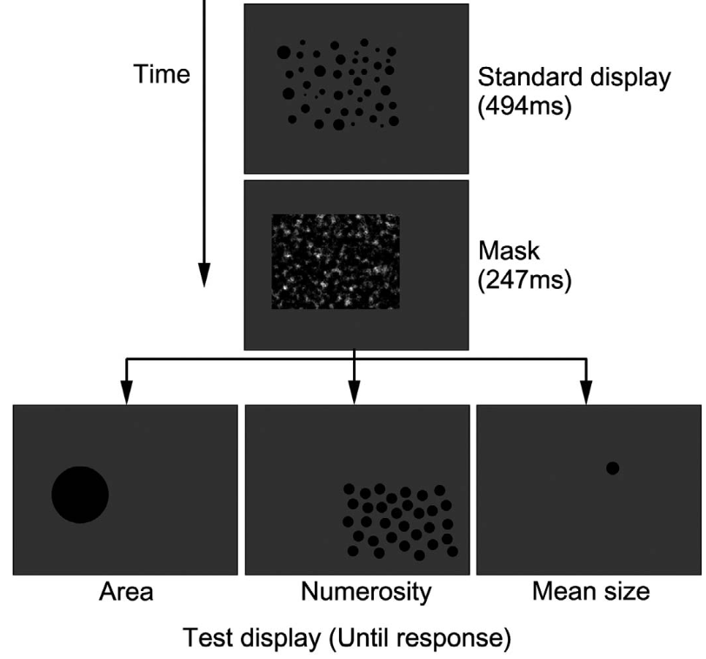
This overestimation increases as discrepancy in set size increases.
Mean size task
PSE
Point of Subjective Equality (%)
Number of Items
in the Standard Display
Lee, Baek, Chong (2016)

Slide 32
Interrelationship between different properties
Observers were able to extract three different ensemble properties of summed area, numerosity and mean size at once from the same display.
Lee, Baek & Chong (2016)
High correlation between the perceived summed area and perceived numerosity.
Lee et al. (2016); Hurewitz, Gelman & Schnitzer (2006)
Mean judgements depend on the number of items or the variance.
Chong & Treisman (2005); Corbett et al. (2012)
Providing stable mean context over time facilitate variability perception while unstable mean context causes loss in variability sensitivity.
Tong et al. (2015)

Slide 33
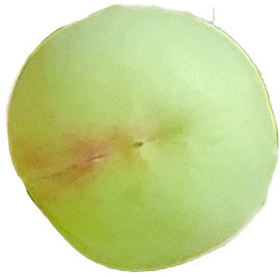
This suggests that representing the mean in terms of a single value requires some form of conversion process.
Stimulus-Response Compatibility
Incompatible response incurs
CONVERSION COST (overestimation of the mean)
??
Fitts & Posner (1954)

Slide 34
This suggests that representing the mean in terms of a single value requires some form of conversion process.
Stimulus-Response Compatibility
Incompatible response incurs
CONVERSION COST (overestimation of the mean)
Overestimation
Fitts & Deininger (1954)
M

Slide 35
EXPERIMENT 1
Design & Procedure
1 factor (Single Probe, Set Probe) within-subjects
2 sessions (one probe type per session)
Test Display
(Until response)
Fixation
(500-1000 ms)
(75 ms)
Fixation
(25 ms)
Stimulus Display
(100 ms)
Blank
(500 ms)
Single Probe
+
+
+
+
Set Probe
Select 1 random
Truncated 2 sd
Select 15 random
M = 1.13 ~ 2.26
sd = 1/8 of M

Slide 36
EXPERIMENT 1
Overestimation & response variance significantly bigger in single probe.
( n = 6 )
( n = 6 )
*
**

Slide 37
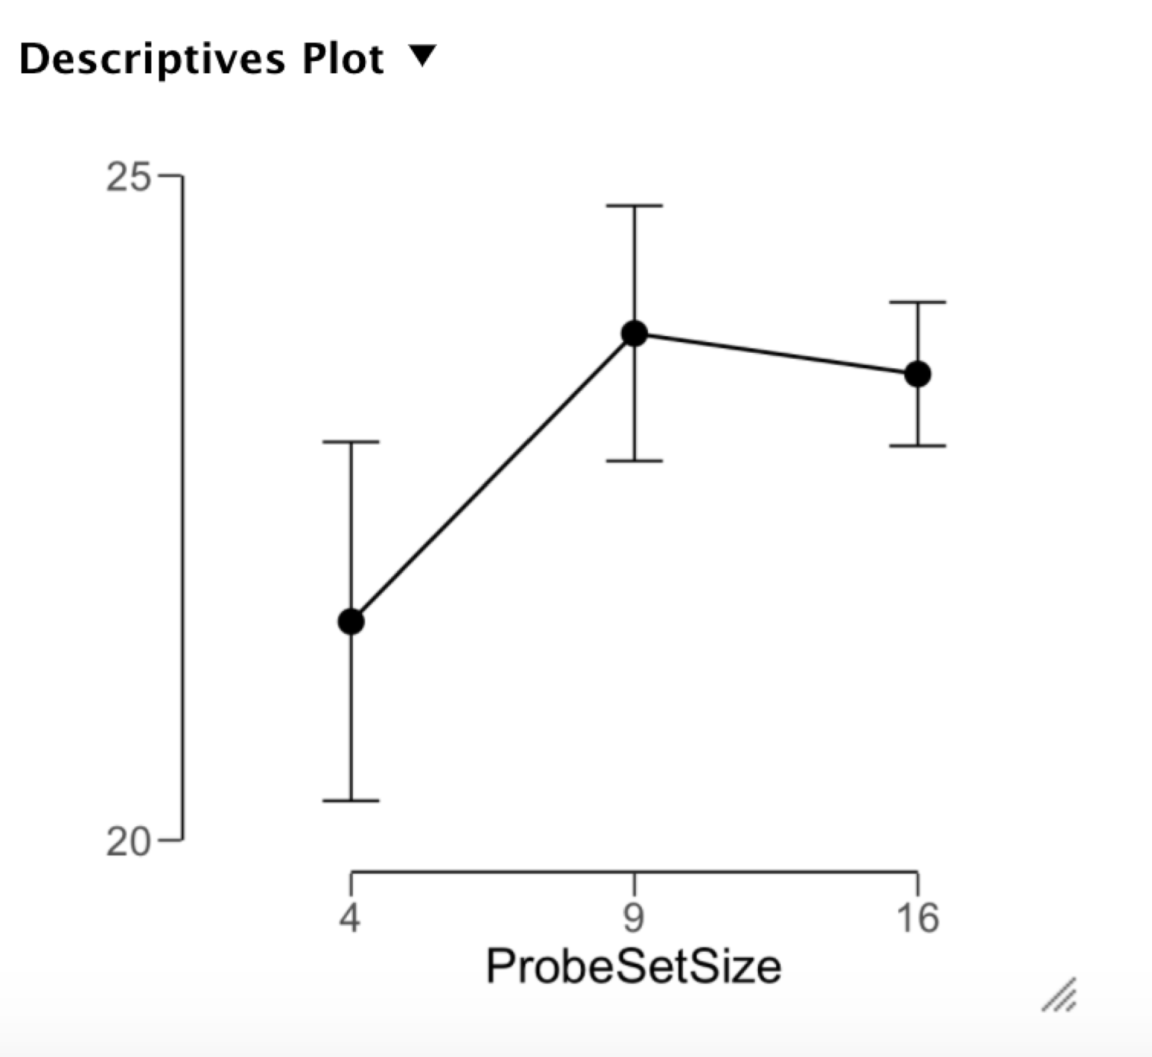
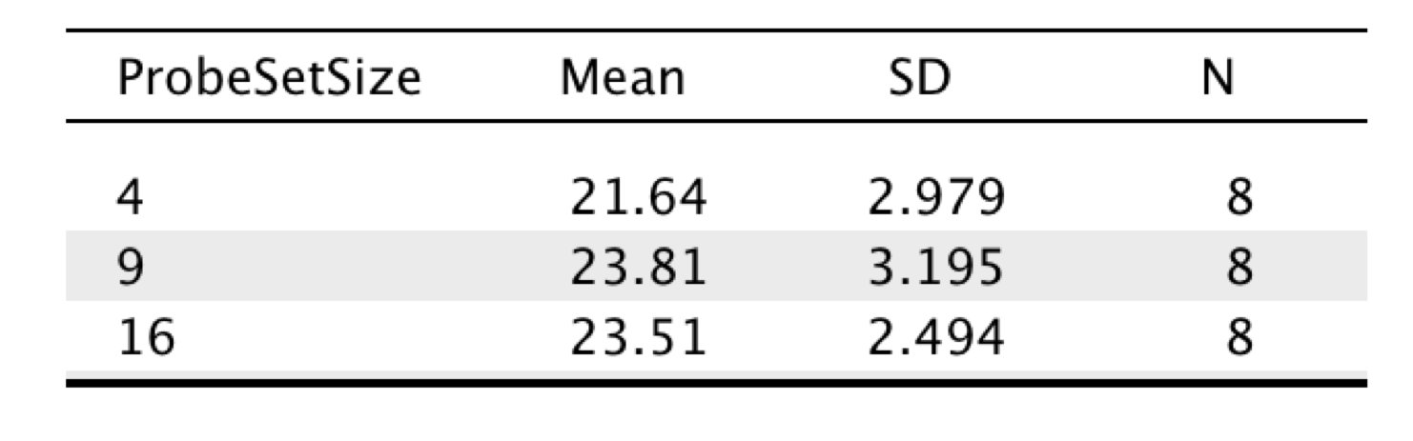
EXPERIMENT 2
Variance of each set size conditions

Slide 38
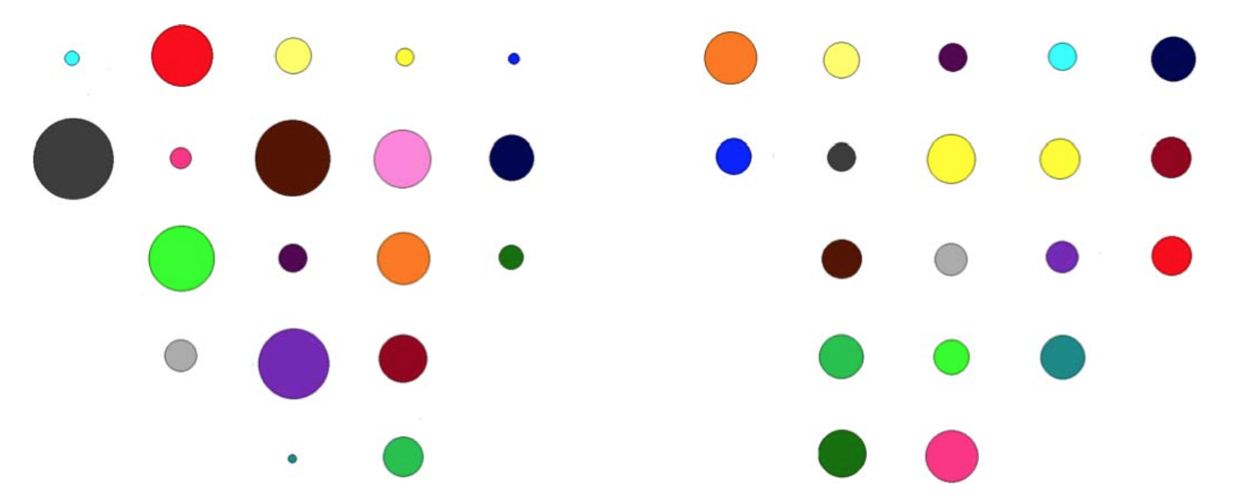
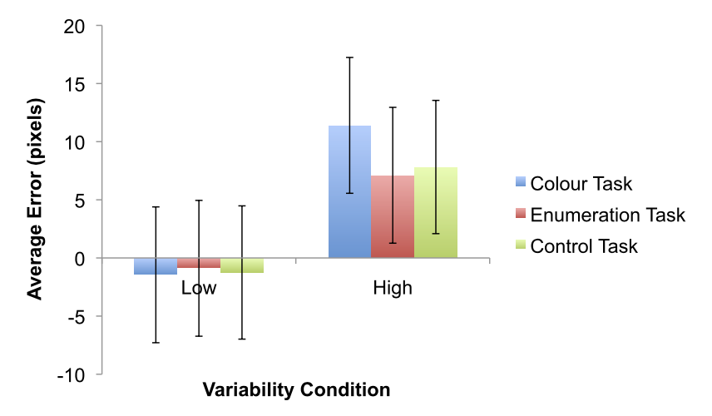
EXPERIMENT 3
In fact, in a single probe task, mean size overestimation was found for high variability set but not in low variability set.
High Variability
Low Variability
Adjust to mean
Oriet & Hozempa (2016)
Single item have same variance as low variability condition.
If mean perception bias is indeed due to variance difference, representation may be more about the ‘distribution of sizes’ or ‘shape of distribution’.
Notes:
Single item can be seen to have same variance as low variability.
If mean perception bias is indeed due to variance difference, thus conversion while reconciling difference in variability,
It is not the number information that is critical, but more about the ‘distribution of sizes’ or ‘shape of distribution’.

Slide 39
Summary
Accurate comparison of mean size was contingent on characteristic disparity of probe display.
Strong evidence that mean is not represented as a single unit, but includes ensembles of statistical properties, as numerosity and variance.
Single size
Distribution

Slide 40
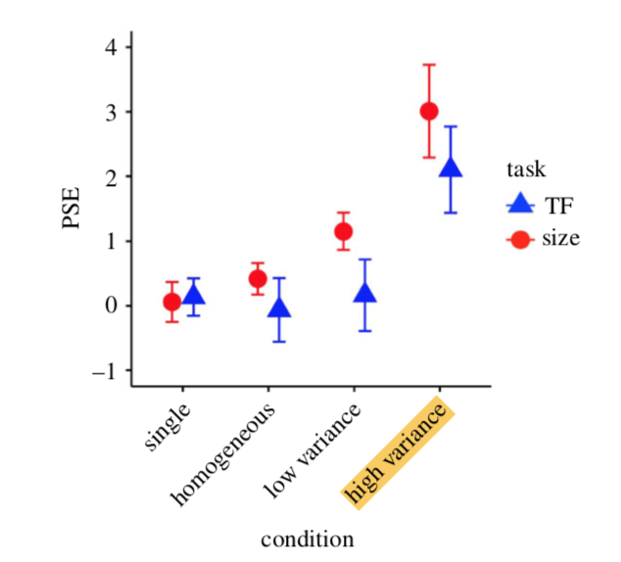
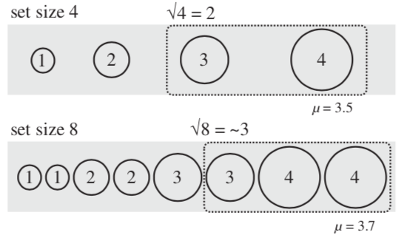
Why is the direction of bias ‘positive’?
SALIENCY-BASED WEIGHTING
Kanaya, Hayashi & Whitney (2018)

Slide 43
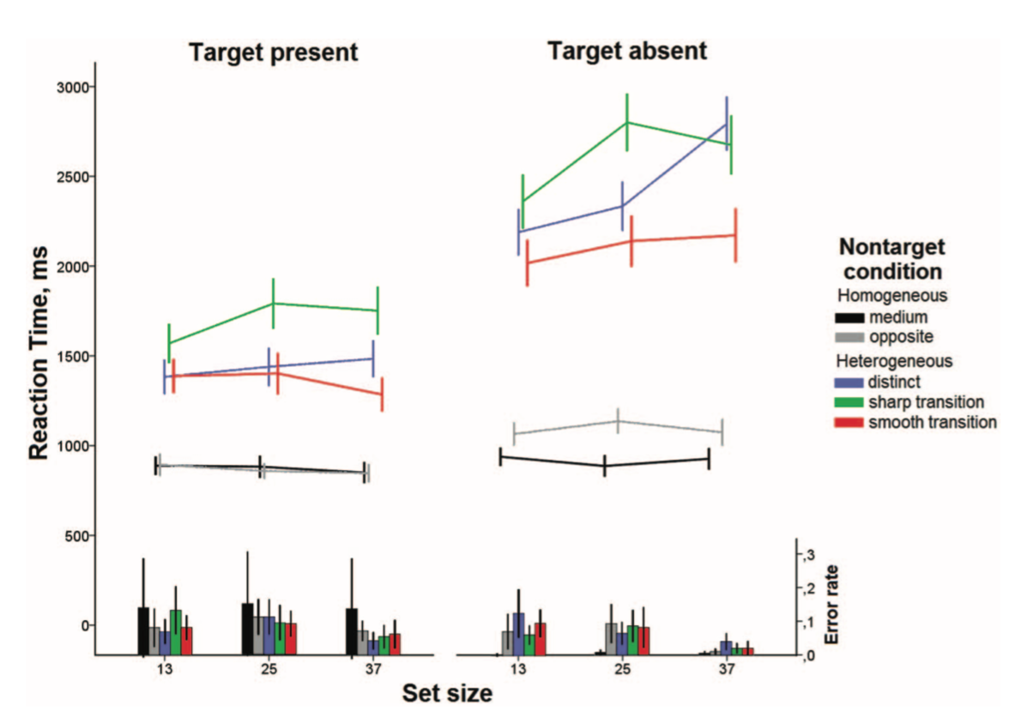
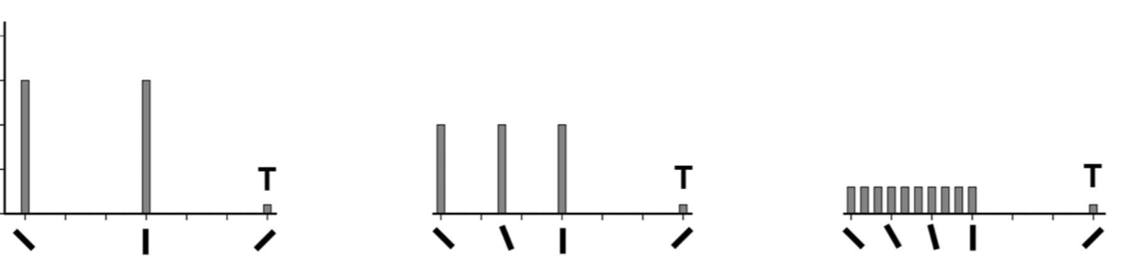
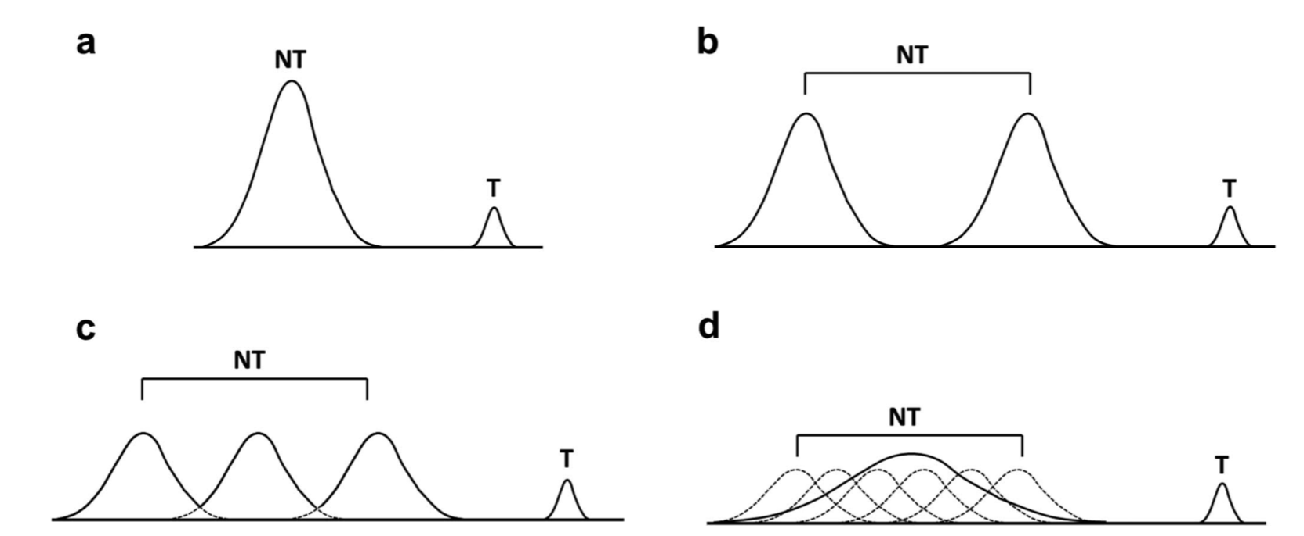
Chetverikov, Campana, & Kristjansson (2016)

Slide 44
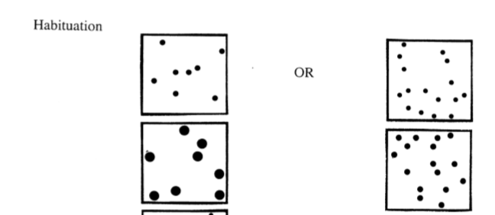
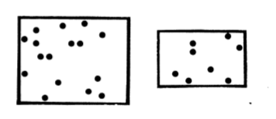
Numerosity threshold
Six-month-old infants show successful discrimination when differ by a
ratio of 2.0 (8 vs. 4, 16 vs. 8, 36 vs. 16) but failure 1.5 (6 vs. 4, 12 vs. 8, 24 vs. 16).
Habituation
Test
Xu & Spelke (2000); Xu, Spelke & Goddard (2005)
EXP 2
16:4 16:9 16:16
>
16:4 16:8 16:16
EXP 3
9:4 9:9 9:16
>
9:4 9:9 9:18

Slide 45
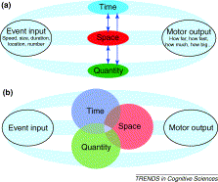
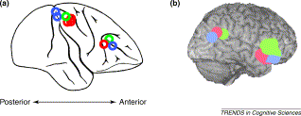
Population Coding
Georgopoulos, Schwartz & Kettner (1986)
Walsh (2003)

